Slide 1
Star Rating PREDICTION
By Avinash Patel

Slide 2

INDEX
Importing Dataset
Cleaning The Dataset
Visualization
Model Selection
Hyperparameter Tuning
Saving The Model

Slide 3
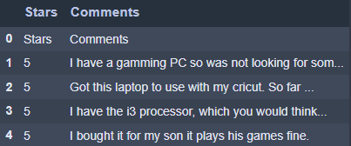
Importing Dataset
First step is to import the csv file into the Jupiter notebook.

Slide 4
After importing we check any of the columns have null values or not and also see some basic information's about all the columns.
Like number of unique variables in each columns.

Slide 5
Cleaning The Dataset
After some information about the dataset we are going to clean the columns individually.
Categorical Column: Both of the columns are categorical columns but we will convert all these columns into numerical columns as the models could not understand the string input so we have to feed the model integer input to work properly.
Columns:
For Treating Stars column: I Deleted all the null rows and some rows where instead of numerical stars only stars is written which is wrong and secondly I converted all the values into integer values.

Slide 6
For Comments column: This column have some amount of null values which I deleted and the I converted all the comments into lower symbols as the model is case sensitive the I treated the row by removing any actual URL with word “URL” and any number s with the word “number” and then I removed all the punctuations and removed all the white spaces with only one space.

Slide 7
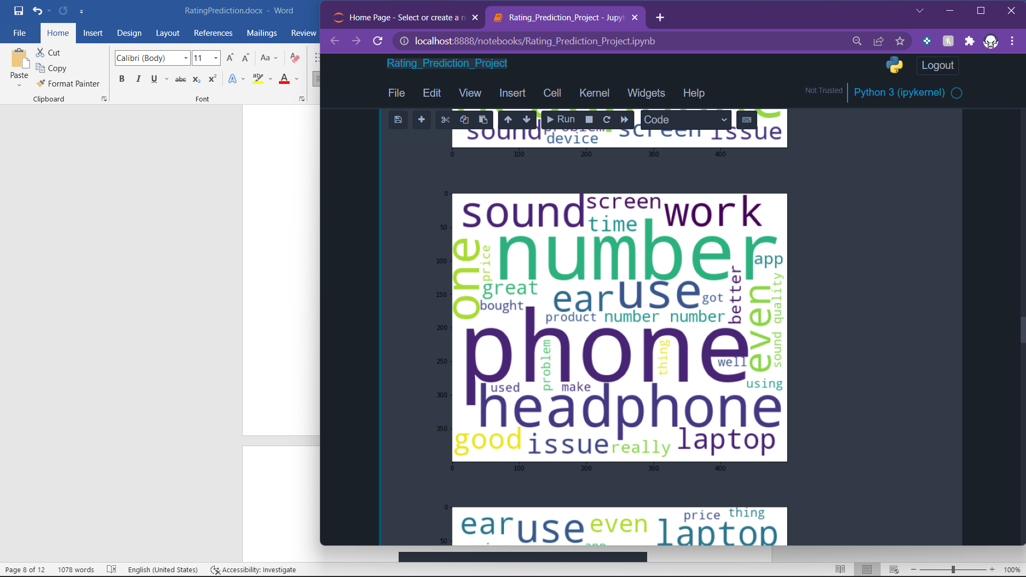
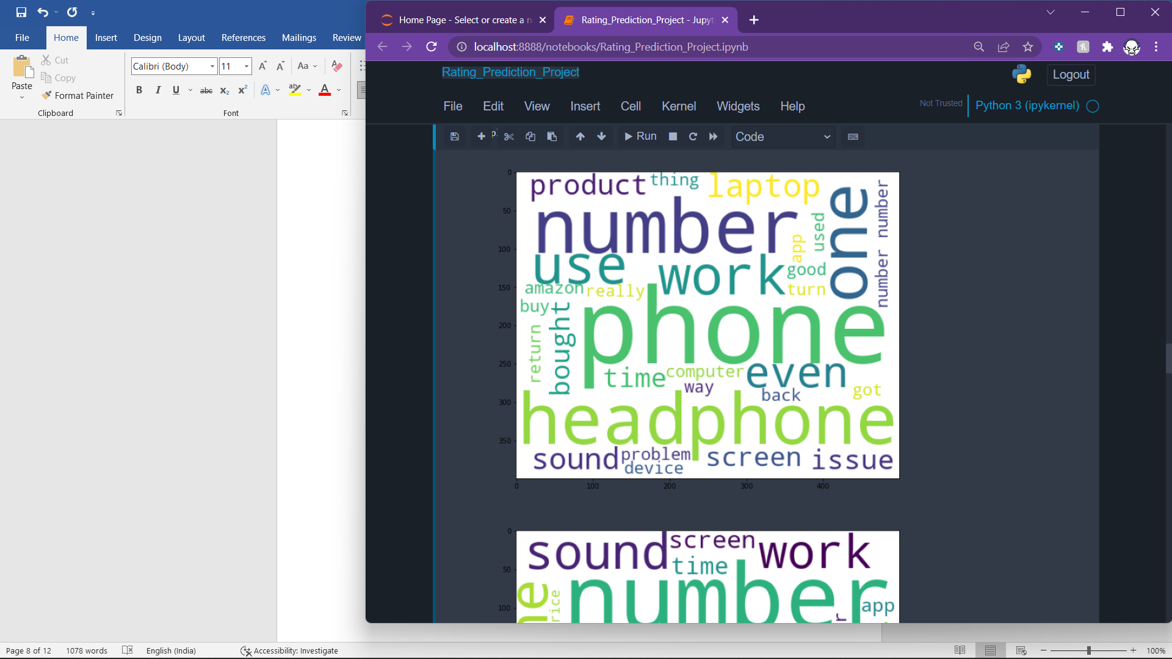
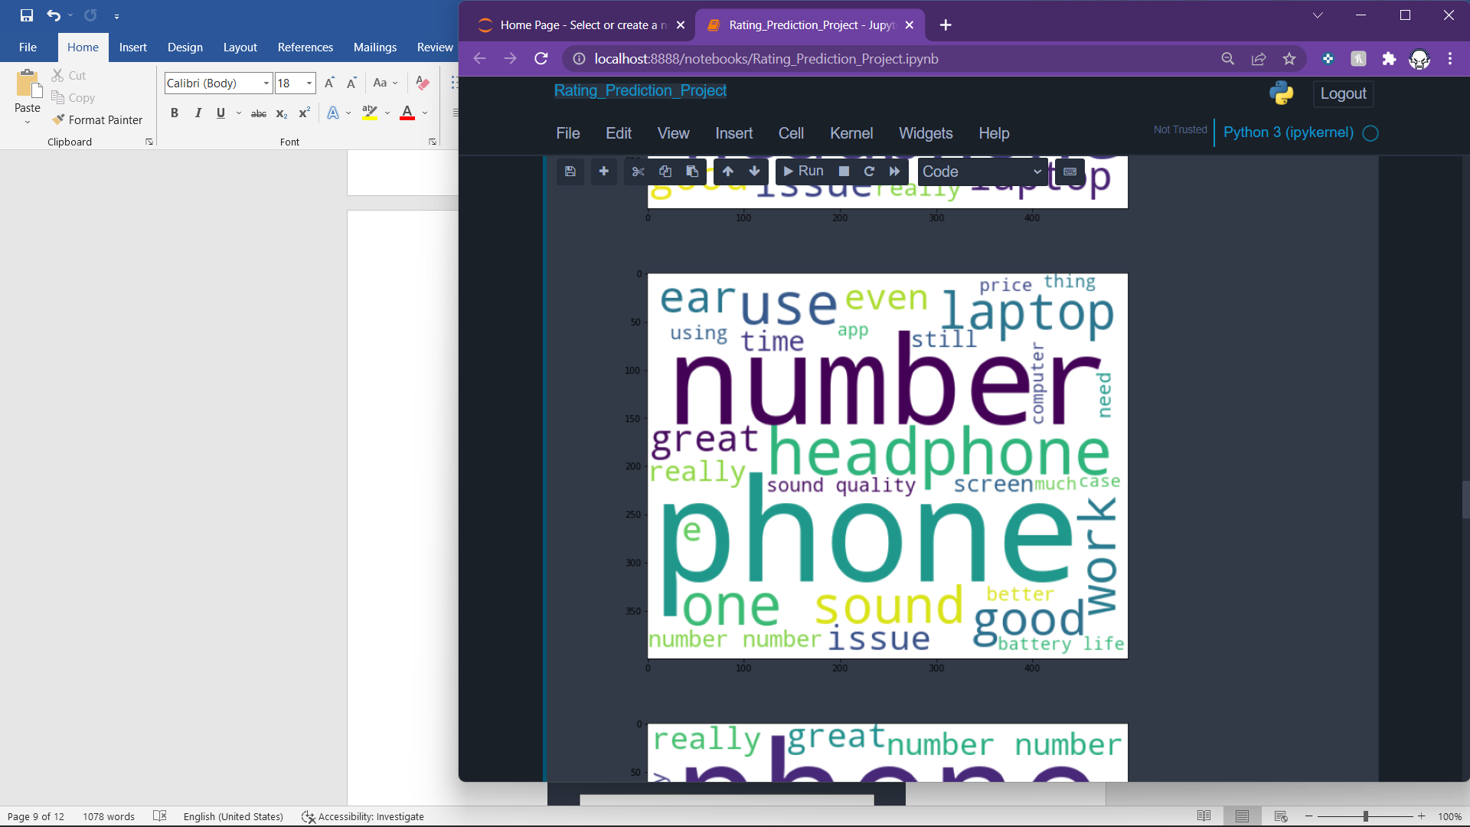
Visualization
WordColud:

Slide 8
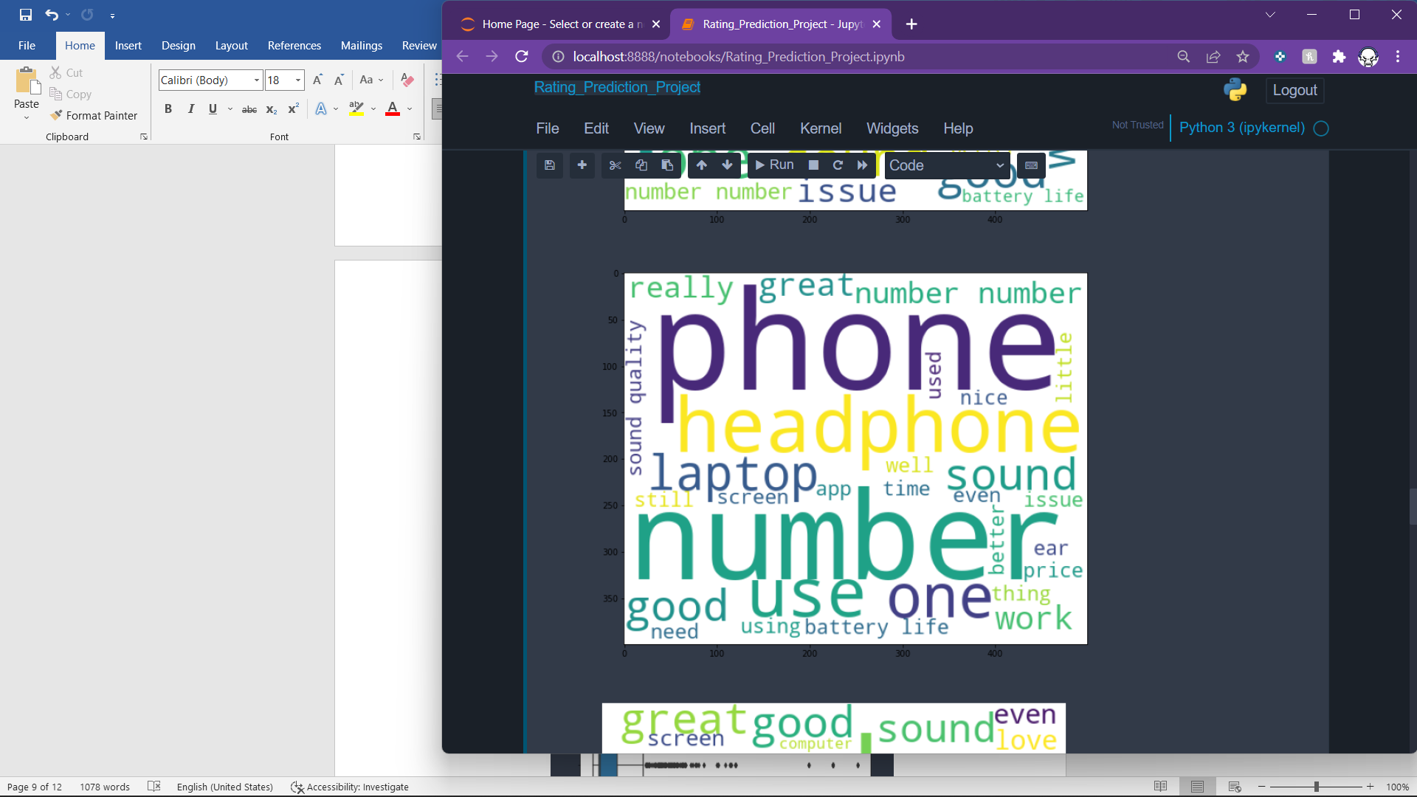
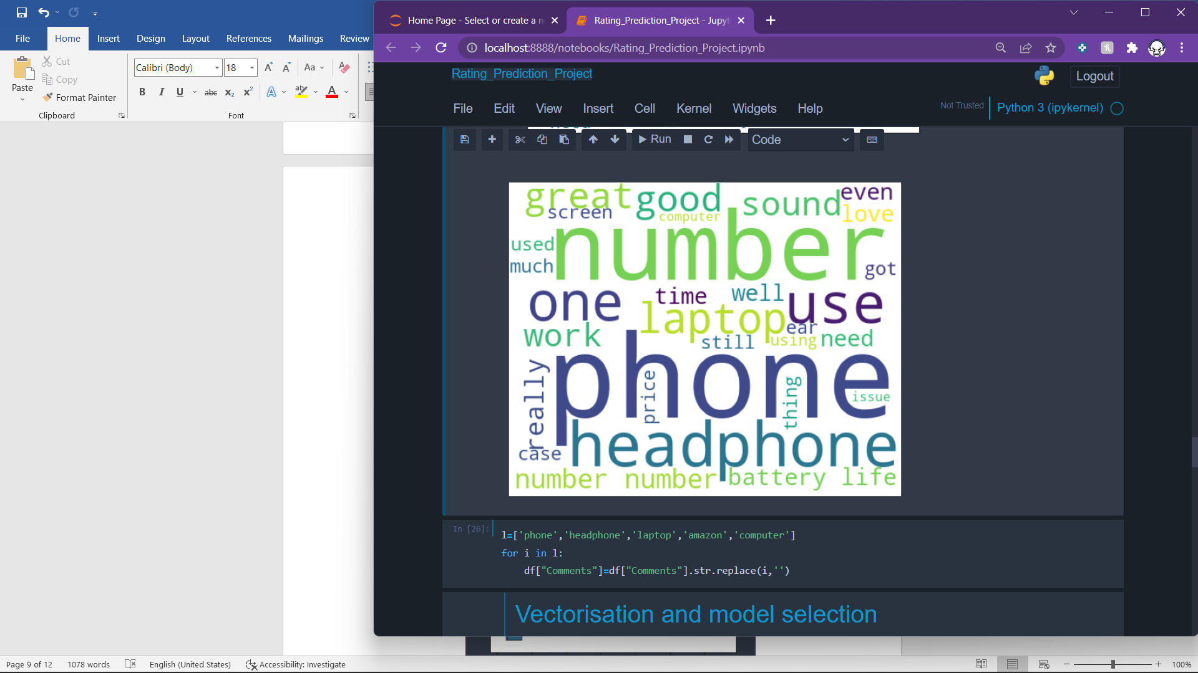

Slide 9
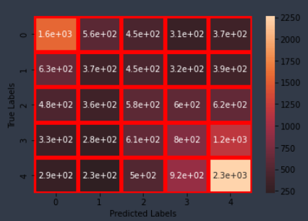
Heatmap for confusion matrix:

Slide 10
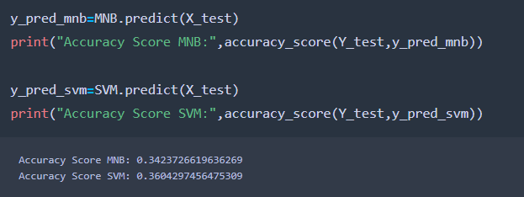
Model Selection
Now we will see some accuracy so that we can select the best fit model for our project.
Hence SVM has the highest score so it will be or model.

Slide 11
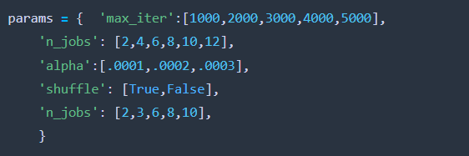
Hyperparameter Tuning
Now as we selected SVM as our model. Now we are going to tune its parameters to make the model a little better.
Parameters are:

Slide 12
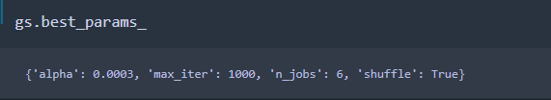
After doing the tuning we find out the following.
The Above parameters are the best parameter for this type of dataset for our model. So finally we fitted the data with these parameters.

Slide 13
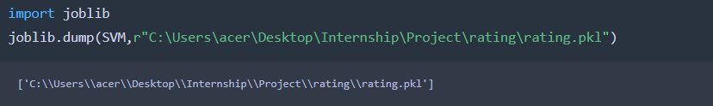
Saving The Model
The final job is to save the model which is done by Joblib library.

Slide 14
THANK YOU!!!

